Slide 1
MacOS Incident Response
Aung Myint Myat

Slide 2
Speaker Profile
Aung Myint Myat is currently working as a threat hunter at ExpressVPN in Singapore. I spend most of the time building security tools and hunting adversaries. From threat hunting, incident response, and engineering security tools, I do all the cool stuff.
Disclaimer
Opinions expressed are solely my own and are not related to any of my previous or present employers.
The materials presented are based loosely on publicly available research and discoveries.
The examples shown in this presentation may violate corporate security policies. Proceed with caution and at your own risk.
I am not responsible for any damage or issues that may arise.

Slide 3
Contents
Introduction
Forensic Acquisition
Evidence Profiling
Forensics Artifacts
Logging and Analysis
Considerations with Incident Response
An Approach to macOS triaging

Slide 4
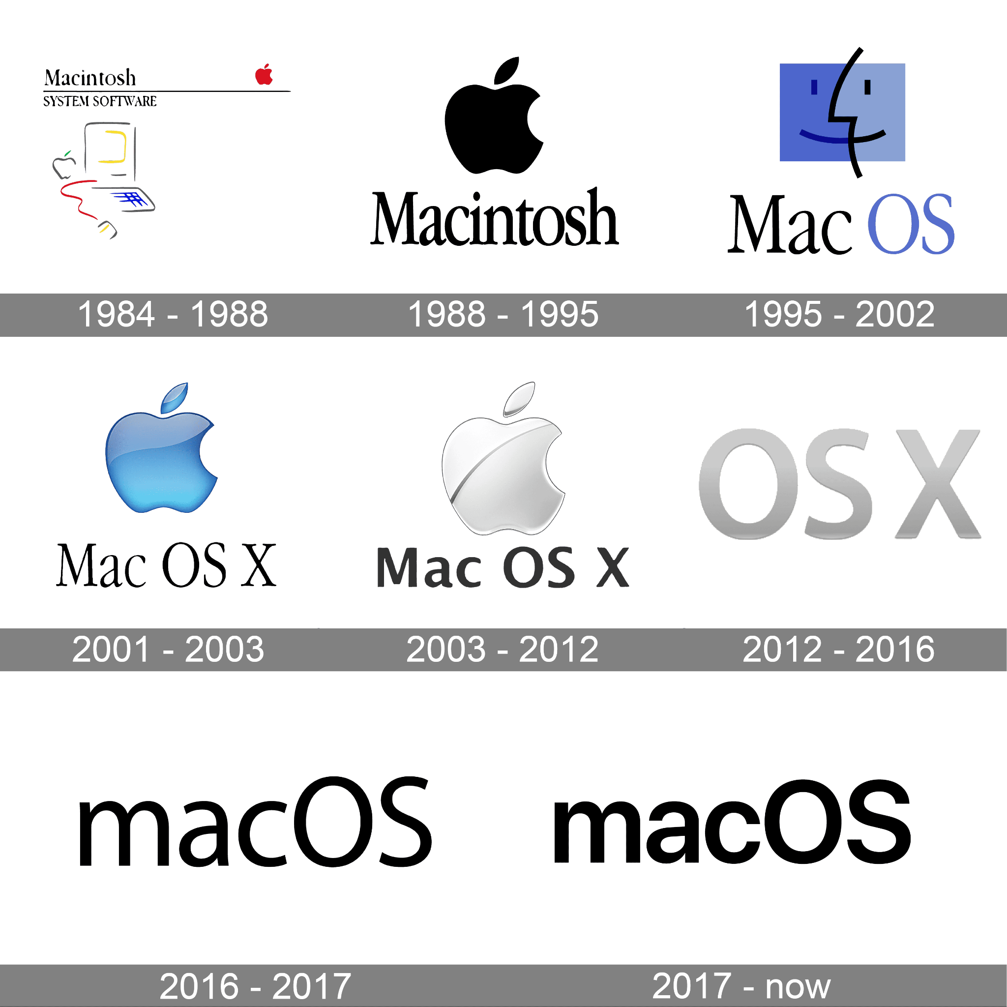
MacOS brief history
MacOS are mostly on endpoints.
Until OS X 10.12, HFS+ file system is used. - Timestamp is limited to 1 sec - Don’t support date beyond 2040 - Snapshot is not possible
APFS on macOS 10.13 in the year 2017. - Solved all HFS+ issues - Full disk encryption is native - Instead of journaling, it uses Atomic Safe Save (ASS)

Slide 5
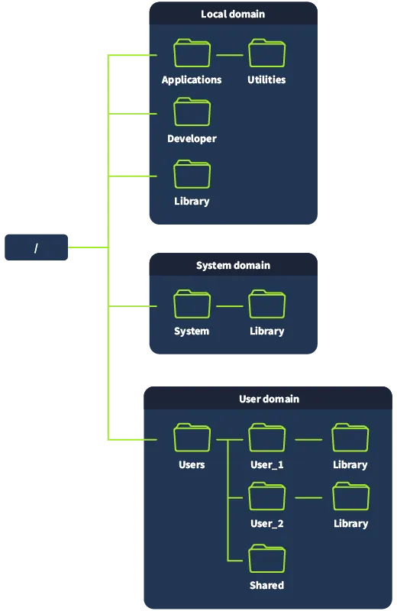
File Structure
User Domain
Home Directory - /Users/<username>/ - .Trash - .zsh history
Public Directory
User Library - /Users/<username>/Library/ - Application sandboxes, Preferences, Caches
Network Domain

Slide 6
Standard Directories and Extensions
Directories
/bin - Standard binaries /sbin - System binaries /dev - Device files /opt - Optional software /private - tmp, var, etc config files
File Extensions
.dmg - Disk images .kext - Kernel Extension (deprecated) .plist - Property list .app - Applications .dylib - Dynamic Libraries .pkg - Packages .xar - Archive files (often installer)

Slide 7
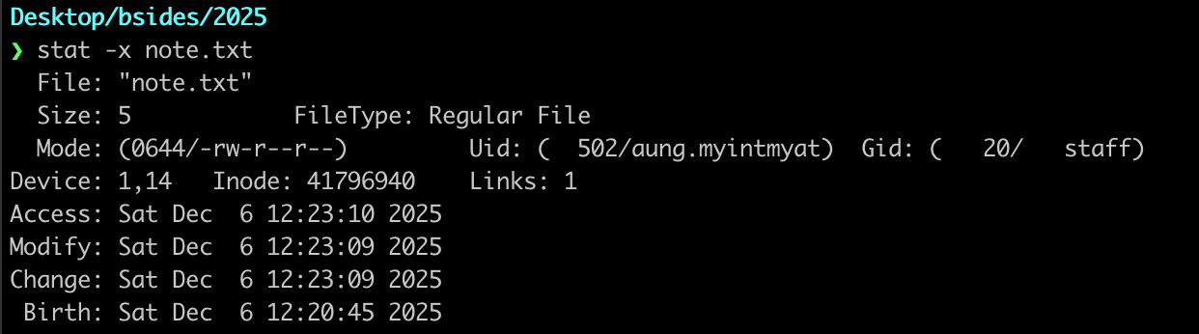
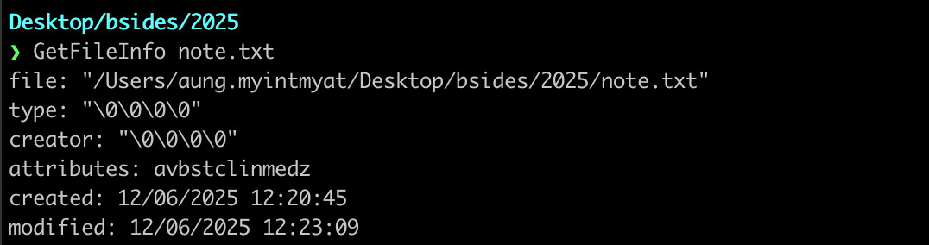
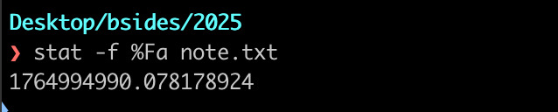
Time
MacOS follows Unix time of 64 bit (APFS)
File system tracks up to nano second. But it only shows up to second normally.
# stat -x <filename> # GetFileinfo <filename>
# stat -f %Fa <filename> —> a,m,c for access, modification, change

Slide 8
Acquisition
Challenges
Physical disk access
Hardware Encryption
FileVault Encryption
Full Disk Access
System Integrity Protection
Notes:
System Integrity Protection (SIP) is a feature that protects the kernel from unauthorised access, code injection, debugging, or general modifications.

Slide 9
Acquisition Tools
Commercial Tools - Magnet AXIOM, Cellebrite
Direct Access tool - dd, hdiutil, dc3dd
Remote analysis tools - EDR, velociraptor

Slide 10

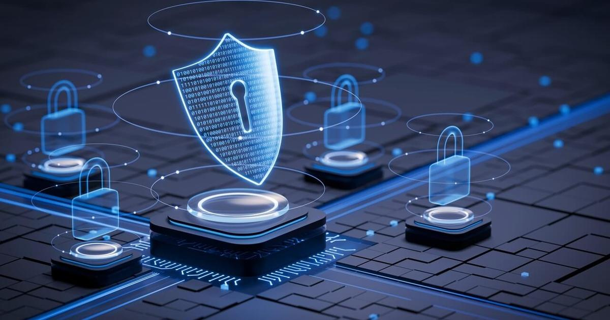
Image Mounting
Commercial tools
Mount on macOS - with apfs_mounts
Mount on Linux - with apfs_fuse # apfs-fuse -o ro,allow_other ewf1 /mnt/apfs_mount
Make sure to mount as rdonly, noexec, noowners
Notes:
Easier to mount on Mac, this does not require any more drivers and dependencies. But It needs to be prepare a bit to safely mount.
On linux, as long as all the prerequisite packages are there, mounting is just one command.

Slide 11
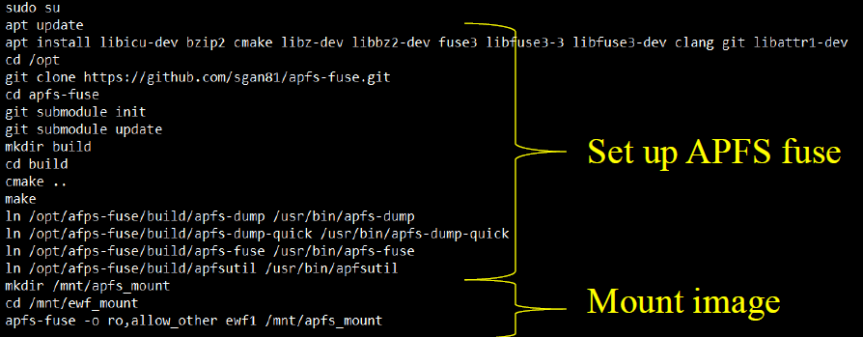
Mounting on Linux

Slide 12
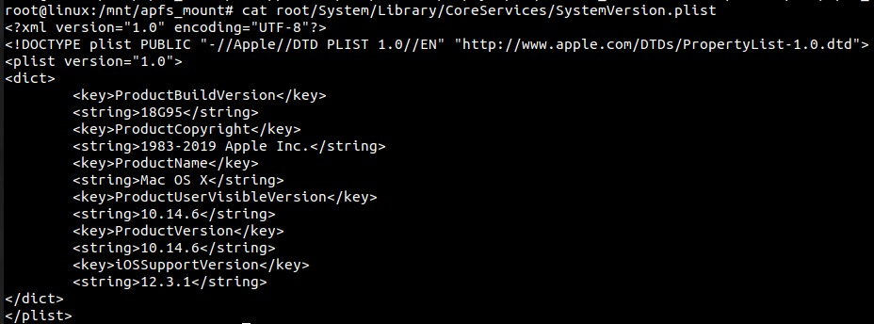
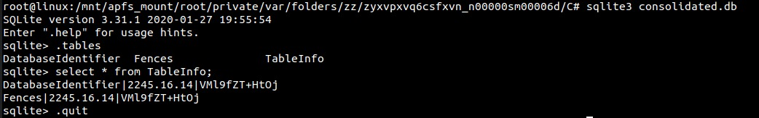
Evidence Profiling
OS version, serial number
OS version - /System/Library/CoreServices/SystemVersion.plist
Serial Number - /private/var/folders/zz/zyxvpxvq6csfxvn_n00000sm00006d/C

Slide 13
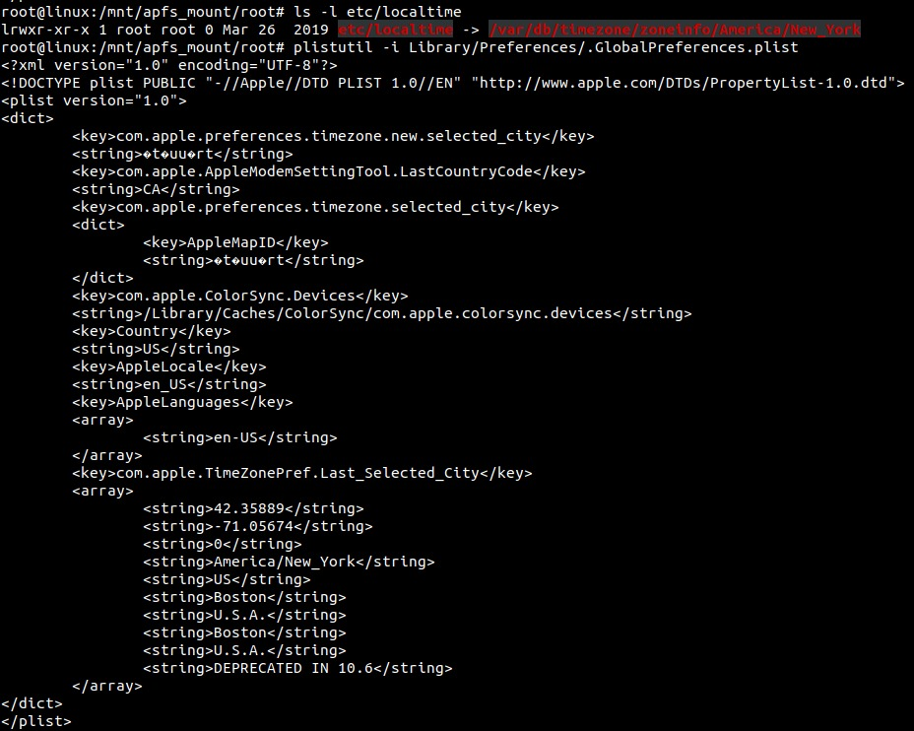
Evidence Profiling
Time Zone
/etc/localtime
/Library/Preferences/.GlobalPreferences.plist

Slide 14
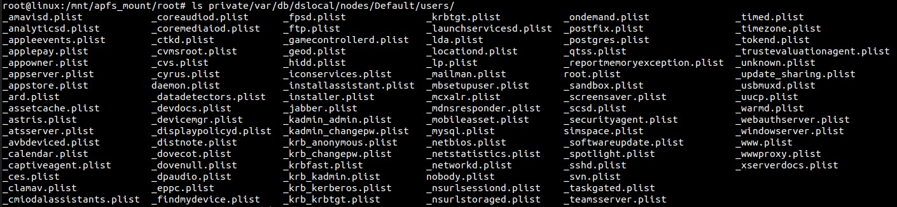
Evidence Profiling
Note: /etc/passwd don’t show everything. Each user account has a separate plist file. Names starting _* are service accounts
User Accounts
/private/var/db/dslocal/nodes/Default/users /private/var/db/dslocal/nodes/Default/groups

Slide 15
Evidence Profiling
Network Configurations
/Library/Preferences/SystemConfiguration/NetworkInterfaces.plist /Library/Preferences/SystemConfiguration/preferences.plist /private/var/db/dhcpclient/leases/ /Library/Preferences/com.apple.wifi.known-networks.plist
Information gathered : Interface, network type, MAC address, model, computer name, network configuration, DNS information, proxies if in used, SSID, Router IP and MAC, lease start date.
Notes:
Com.apple.wifi.known-networks.plist :
{
"wifi.network.ssid.2 Floor 1" => {
"__OSSpecific__" => {
"ChannelHistory" => [
]
"CollocatedGroup" => [
]
"RoamingProfileType" => "None"
"TemporarilyDisabled" => 0
}
"AddedAt" => 2024-03-20 21:31:02 +0000
"AddReason" => "Cloud Sync"
"CaptiveProfile" => {
"CaptiveNetwork" => 0
}
"Hidden" => 0
"JoinedBySystemAtWeek" => 1211
"JoinedByUserAt" => 2024-03-20 21:31:02 +0000
"Moving" => 0
"PrivateMACAddressEvaluationState" => 1
"SSID" => {length = 9, bytes = 0x3220466c6f6f722031}
"SupportedSecurityTypes" => "WPA/WPA2 Personal"
"SystemMode" => 1
"UpdatedAt" => 2024-10-04 06:36:19 +0000
}

Slide 16
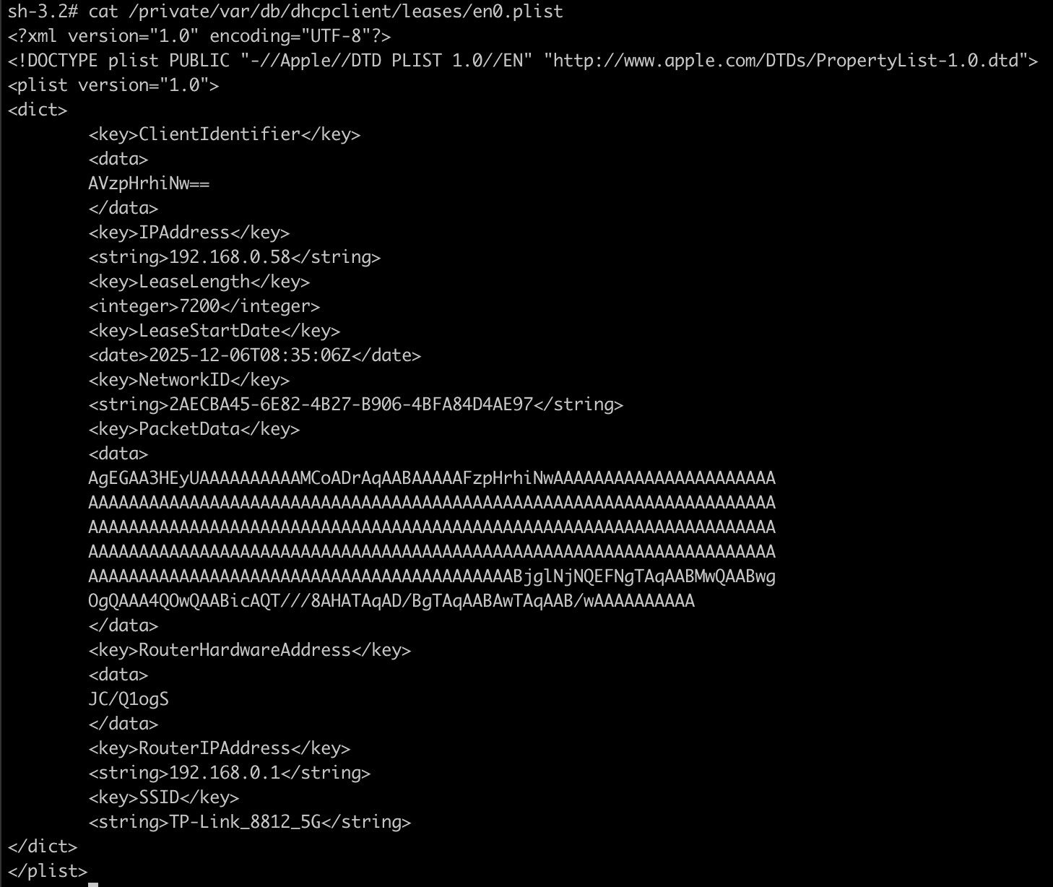
Dhcpclient leases

Slide 17
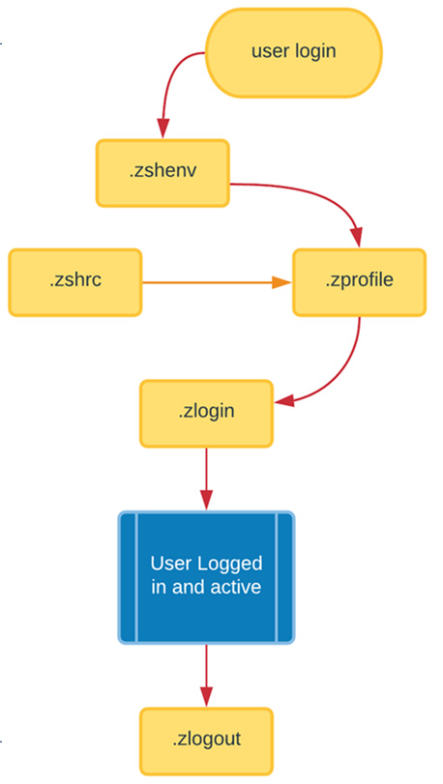
Artifacts: Account Activities
User Shell Artifacts
~/.zshenv (optional)
~/.zprofile
~/.zshrc
~/.zlogin
~/.zlogout (optional)
/etc/zprofile
/etc/zshrc
/etc/zsh/zlogin
User history
~/.zsh_history
~/.zsh_sessions
Note: This applies to any other shells that might be on the system. Check under /etc/.

Slide 18
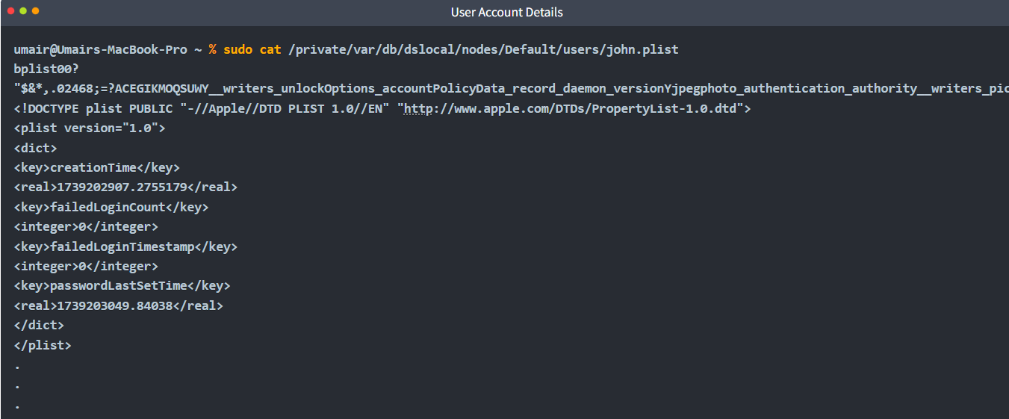
Artifacts: Account Activities
User Plist - /private/var/db/dslocal/nodes/Default/users/<username>.plist

Slide 19
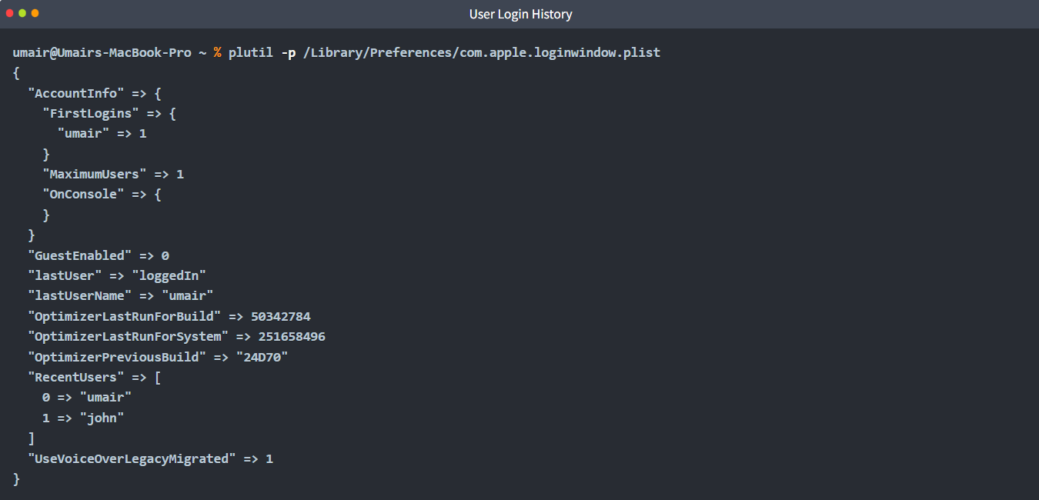
Artifacts: Account Activities
Login History -/Library/Preferences/com.apple.loginwindow.plist

Slide 20
Artifacts: Account Activities
/Users/<username>/Library/Preferences/
Browser downloads
com.apple.LaunchServices.QuarantineEventsV*
Recently Accessed Files
com.apple.shared.plist
com.apple.recentitems.plist
Finder app
com.apple.finder.plist
Keychain preferences
com.apple.keychainaccess.plist
Notes:
com.apple.quarantine
com.apple.metadata:kMDItemWhereFroms

Slide 21
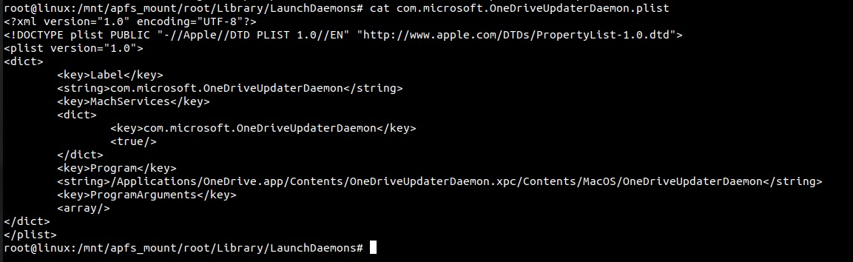
Artifacts: Persistence
Launch Daemons/ Launch Agents
System Startup (root or user)
/Library/LaunchAgents
/Library/LaunchDaemons
/System/Library/LaunchAgents
/System/Library/LaunchDaemons
User Login (user)
/Users/<username>/Library/LaunchAgents

Slide 22
Workflow to analyze Launchd Files
01
02
03
04
Check unusual file names
Check unusual modification dates
Check file content
Validate executable

Slide 23
Logging and Logs
Important Plaintext Logs
/var/log/system.log
/var/log/DiskUtility.log
/var/log/fsck_apfs.log
/var/log/wifi.log
/var/log/appfirewall.log
Application Logs
/Library/logs
~/Library/logs
/Library/Application Support/<app_name>
/Applications
Binary Logs
Apple System Logs
/var/log/asl/*.asl
Apple Unified Logs (*.tracev3)
/var/db/diagnostics/
/var/db/uuidtext/

Slide 24
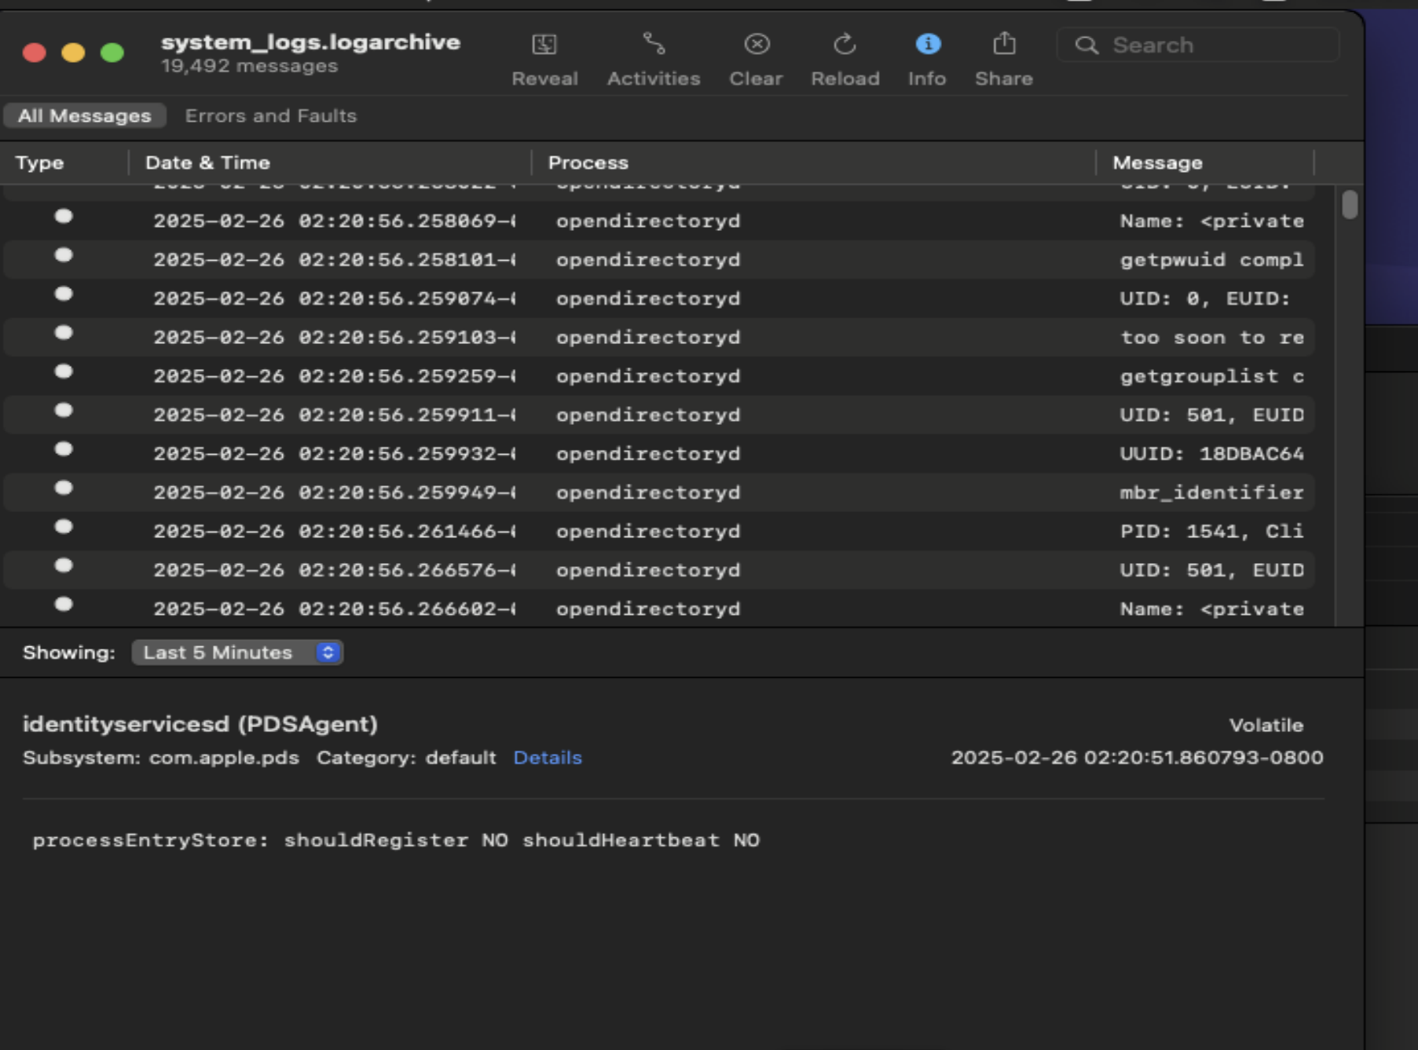
Viewing Apple log formats
ASL logs
# Syslog -f <filename>.asl
AUL logs
# log collect → Collecting all the unified logs (live analysis)
# log show –last 1d > /path/unifiedlog_24h.log
Console app

Slide 25
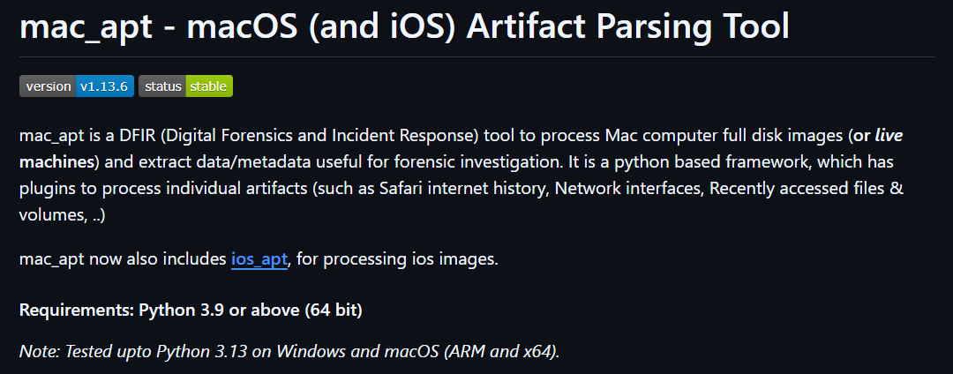
Other Platform?
https://github.com/ydkhatri/mac_apt
Notes:
python /opt/mac_apt/mac_apt.py -o /cases/experiment –csv -d DD /cases/stsupport18_disk.raw UTMPX USERS

Slide 26
mac_apt: Common Plugins for Forensics
ALL : Runs every plugin (around 39 currently available)
FAST : Runs all except UNIFIEDLOGS,SPOTLIGHT, and IDEVICEBACKUPS to speed up collection
SUDOLASTRUN : Last time sudo was run
TERMSESSIONS : Terminal activities
UNIFIEDLOGS : Read .tracev3 AUL files
UTMPX : Read login data

Slide 27
macOS Triage: An Approach
Collect Info & Context
Review unified logs
Time machines snapshots
Gather Volatile data
Persistence & Auto-start
User Artifact Data
Os version, serial number, boot time, hardware, account names, fde, EDRs
Suspicious process, error message, security alerts, network activities, login attempts
In macOS 26 (Tahoe), only os update snapshot is available by default. But if available, consider to mount.
Running Process, network connections, ARP cache, logged-in users,
LaunchDaemons, LaunchAgents, Cron jobs, system profiles, browser extensions.
Shell artifacts, browser history, downloads, gatekeeper logs.

Slide 28
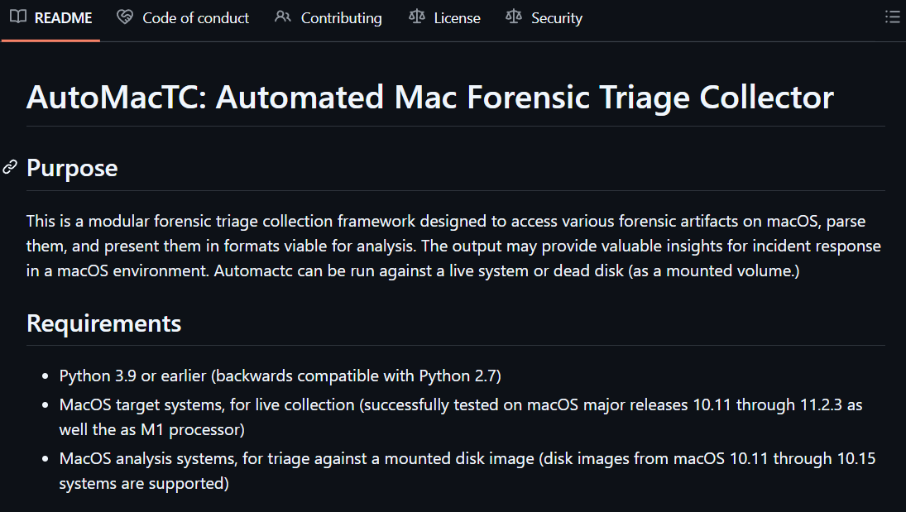
AutoMacTC by CrowdStrike
https://github.com/CrowdStrike/automactc

Slide 29
Quick Wins with macOS
Unified File System Structure - Key user data are in /Users/<user> and system-wide resources are in /System or /Library.
Less Places for Persistence - Mostly on Launch Daemons/Agents, and a few others like (login items, cron jobs, kernel extensions)
Built-in Quarantine Info - macOS might tags downloaded files with the source URL.
Snapshots - Absolutely valuable and by default.
Apple’s AUL - Contains everything that happened in the system. It is on by default. Fields are generous.

Slide 30
Some other considerations
Profiles need to be setup properly for the EDRs to work.
EDR usually are not super strong on mac.
Logs in the mac can be read, removed, modified by the users.
Established the process to react in case of incident.
How, When, Where, Who, What???

Slide 31

Thank you!
Notes:
https://www.youtube.com/watch?v=70CBB9MdNWM&list=PLz4xB83Y3Vbjtqr_ttOkBWZZ_ewEVVPXQ

